Slide 1
DAV6100: IA Final Project: Mission Green
Instructions:
Give your presentation a name and be sure to put your group number in the placeholder.
This template will be use for the final delivery of your project
Group 3
Aquib Hussain Mohammed, Arunesh Kumar Rai, Harshkumar Jeetendra Vaghmaria, Jiahao Li, Mudassir Imam, Shubham Pant

Slide 2
Agenda
Problem Statement
Overview
Project Requirements
Project Milestones & Timeline
Team Responsibilities
Data Profile
Data Model
ER Diagram
AWS Architecture
Demo
Visualization
Assumption
Challenges
Lessons Learned

Slide 3
PROBLEM STATEMENT
Problem Statement: In today's world, as the population increases, we face a significant problem: finding places where the air is clean to breathe and the water is safe to drink. To tackle this issue, we've come together to locate areas with clean air and drinkable water.
Goal Statement: Our goal is to provide vital information to our stakeholders using the given data analyzed, our stakeholders will be able to make informed decisions.
Our Stakeholders: Local governments, businesses, non-profits, Educational institutions, development agencies, and international organizations.

Slide 4




Overview
Mission Green analyses air quality and drinking water inspection data into an AWS data warehouse, facilitating informed decision-making. Our team utilizes data visualization tool Tableau to address the critical challenge of identifying clean air and drinkable water areas.
Datasets: Air Quality &
Drinking Water Inspection
AWS to host Data Warehouse
Tableau for Data Visualization

Slide 5
Project Requirements
1. Design, Document, & Plan
3. Test the Solution
Develop a conceptual design architectures
Develop data flow diagrams and data models
Define analytics concepts with bus matrix
Define ETL Instructions
Define data attributes
A prototype is to be test
Break-testing and optimization of the database may be necessary (use of indexes)
Ensure that error-handling scenarios are considered
2. Develop and Build
4. Present and Deliver
Develop the warehouse solution using Amazon Web Services as the platform
Include two data structures:
Structured dataset
Semi/Unstructured dataset
Integrations:
Batch/Migration
Real-time
Data Visualization
Code Repository (GitHub)
Deliver an executive presentation
Demo the architectural components
Demo the visualizations in a data visualization platform like Tableau

Slide 6





Project Milestones & Timeline
15 Mar 2024
25 Apr 2024
Week 16
Data Warehouse Development
Data Gathering
Final Touches & Prep
Design and Planning
Analyze and Testing
Deliver & Present
Present final solution to class
Determine peer score
21 Feb 2024
11 Apr 2024
5 May 2024

Slide 7

Team Responsibilities
Instructions:
Use this slide to provide the breakdown of the key responsibilities for the members of your group.
Who was responsible for what part of the project?
List the person and their responsibilities.
Project Deliverables | Aquib | Arunesh | Harsh | Jiahao | Mudassir | Shubham
Data Gathering
Design & Planning
DW Development
Analytics and Testing
Final Presentation

Slide 8

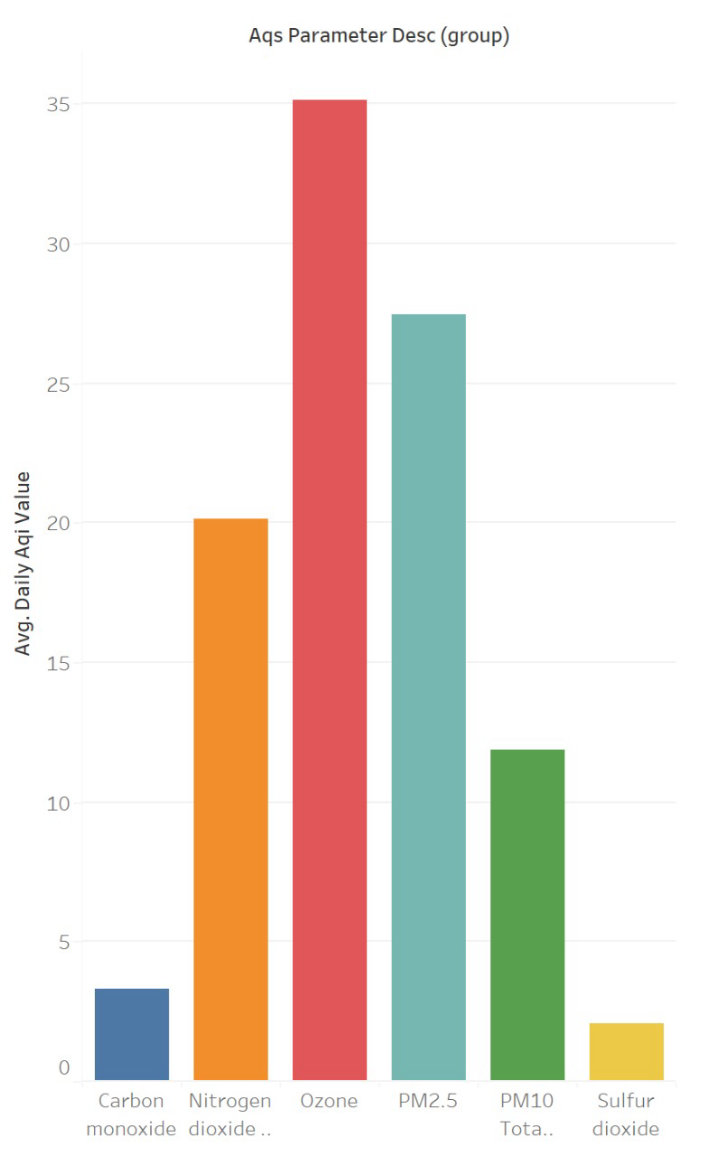

Data Profile: Air Quality Data
Dataset Summary
Source of Information | Air Quality Data
Number of Records | 141676
Frequency of updates | Daily
Data type and structure | CSV and Structured
Number of columns | 21
Granularity | AQI Measurement
Descriptive Statistics

Slide 9
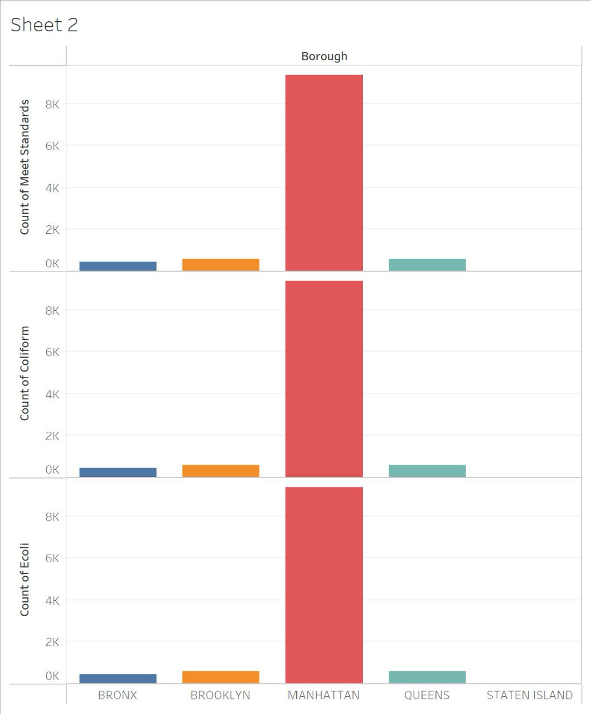
Data Profile: Drinking Water Quality Data
Dataset Summary
Source of Information | Drinking Water Quality Data
Number of Records | 49729
Frequency of updates | Monthly
Data type and structure | JSON and Unstructured
Number of columns | 49
Granularity | Meet standard, E Coli, Coliform
Descriptive Statistics

Slide 10
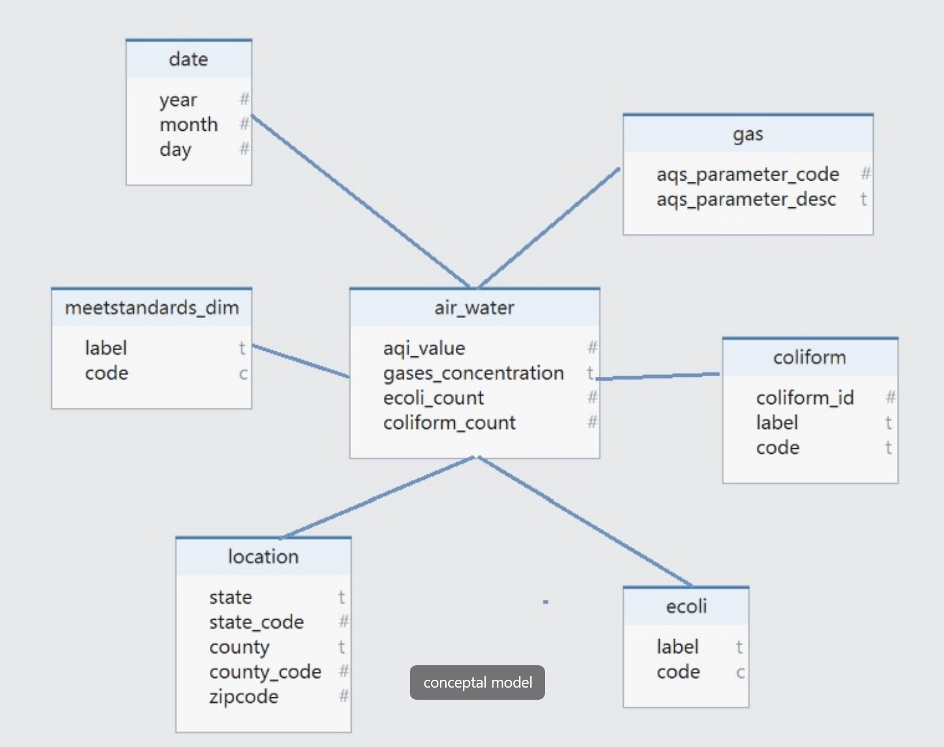
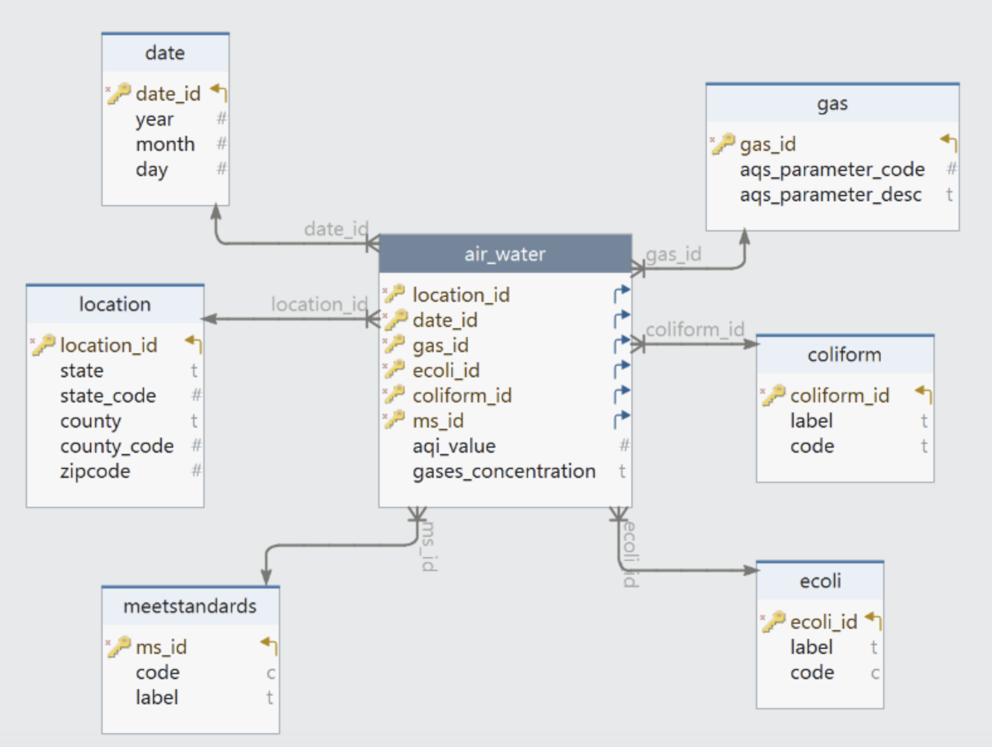
Data Modeling – Conceptual, Logical
Conceptual Data Model
Logical Data Model

Slide 11
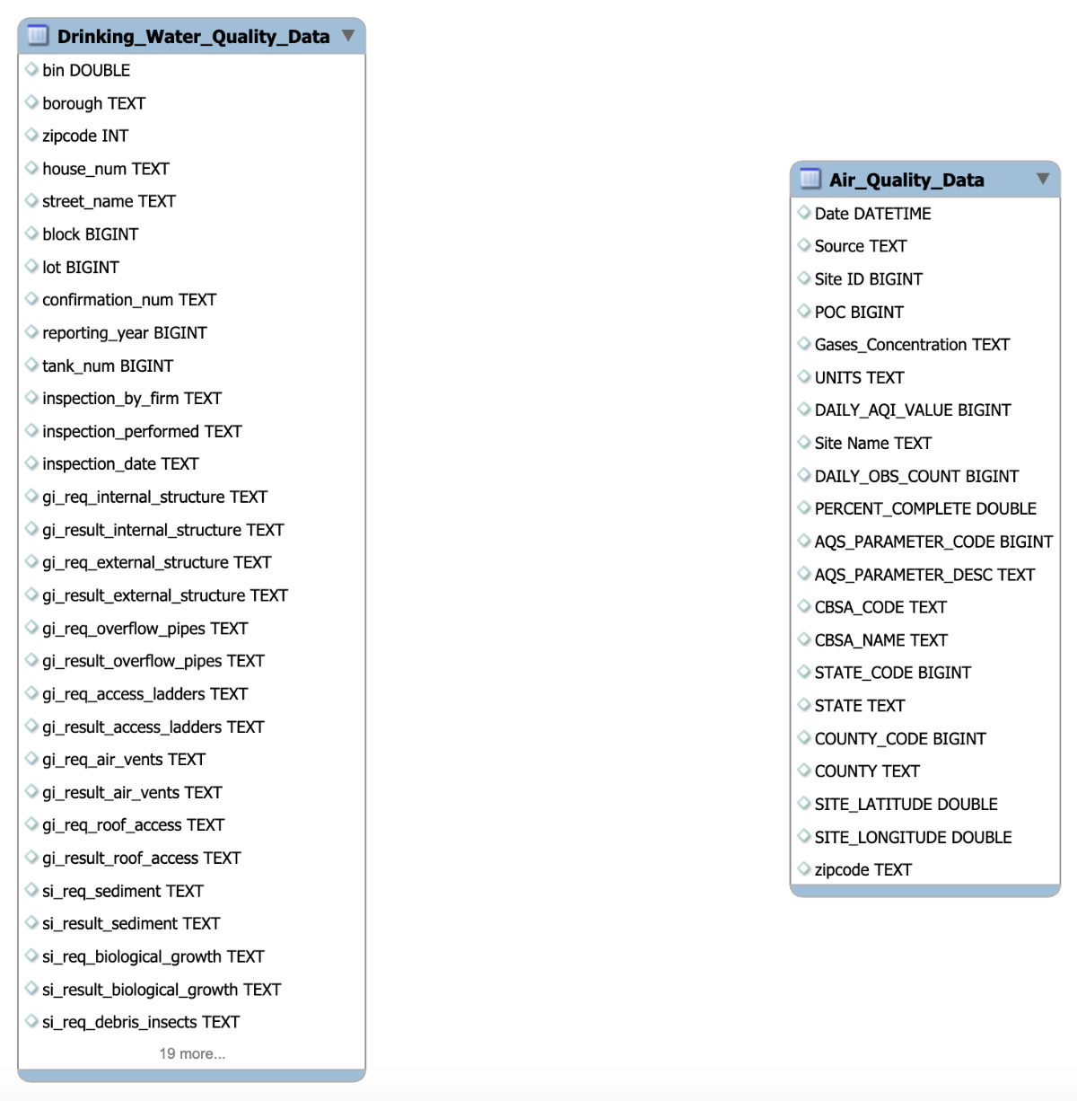
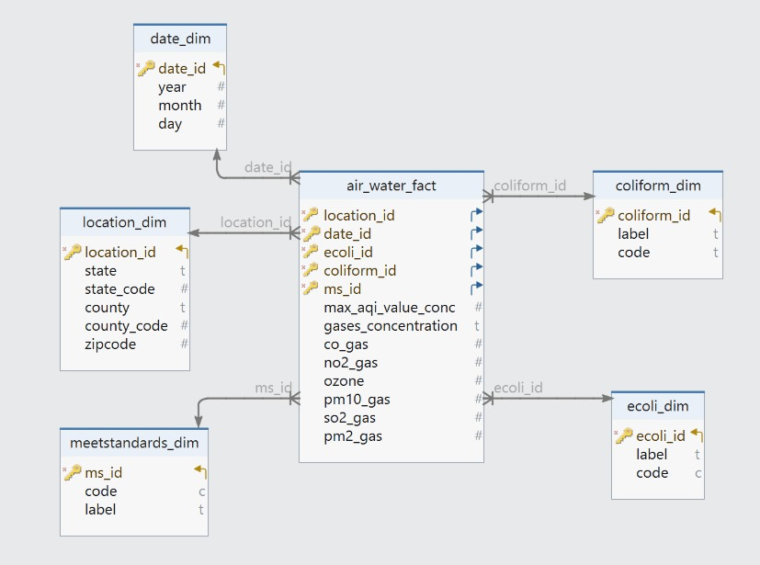
ER Diagram: OLTP - OLAP
OLTP
OLAP - Physical Data Model

Slide 12
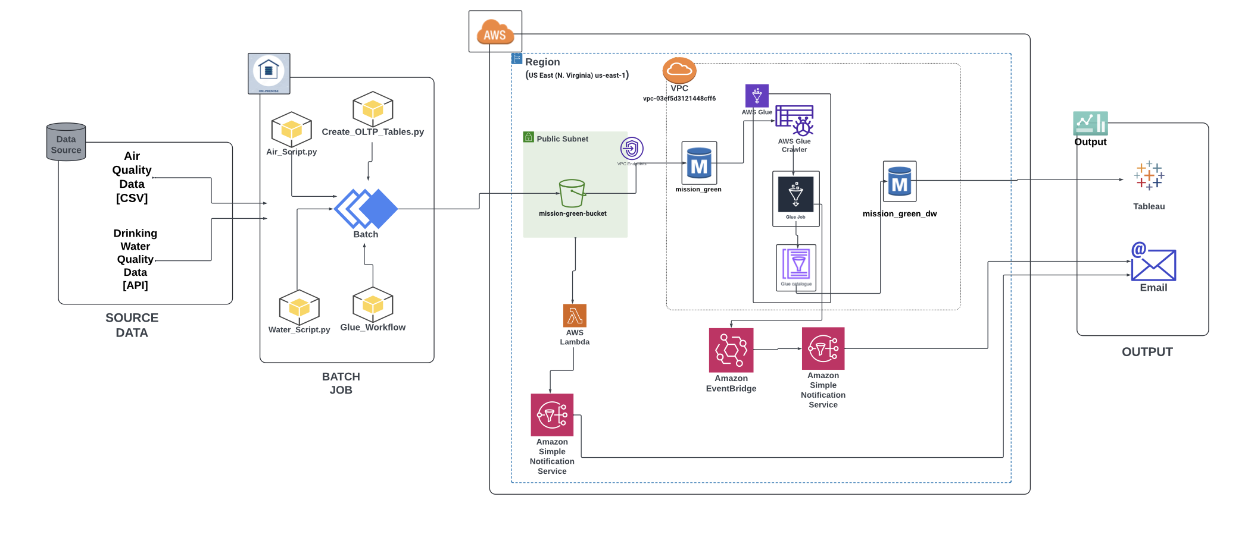
AWS Architecture

Slide 13
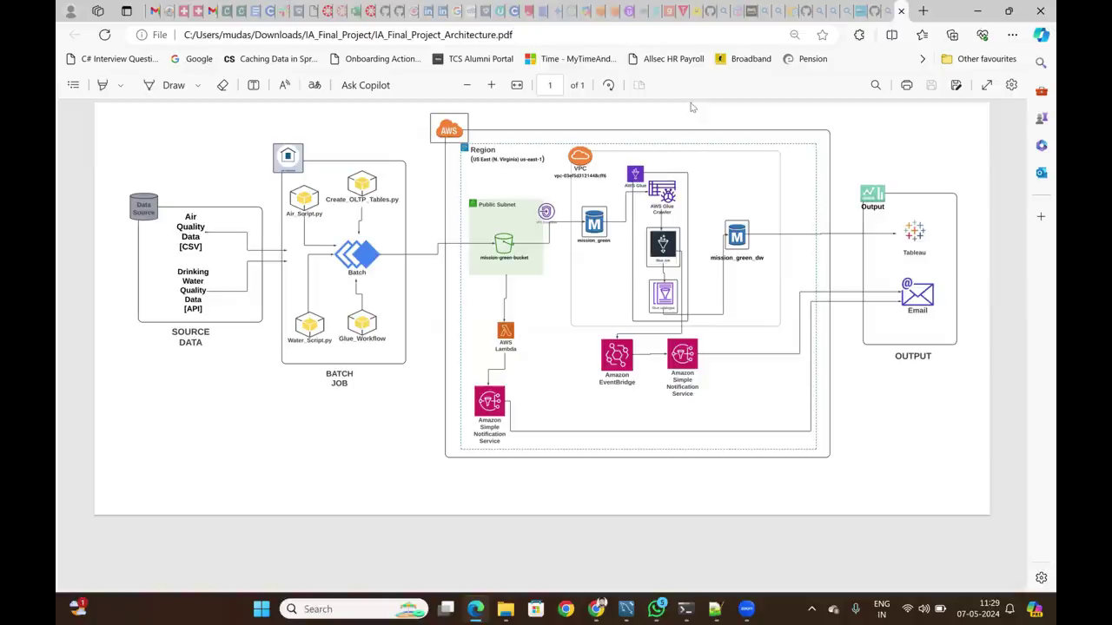
DEMO
Instructions:
This is a placeholder. You do not need to edit, but you should plan to demo your solution at this point!

Slide 14
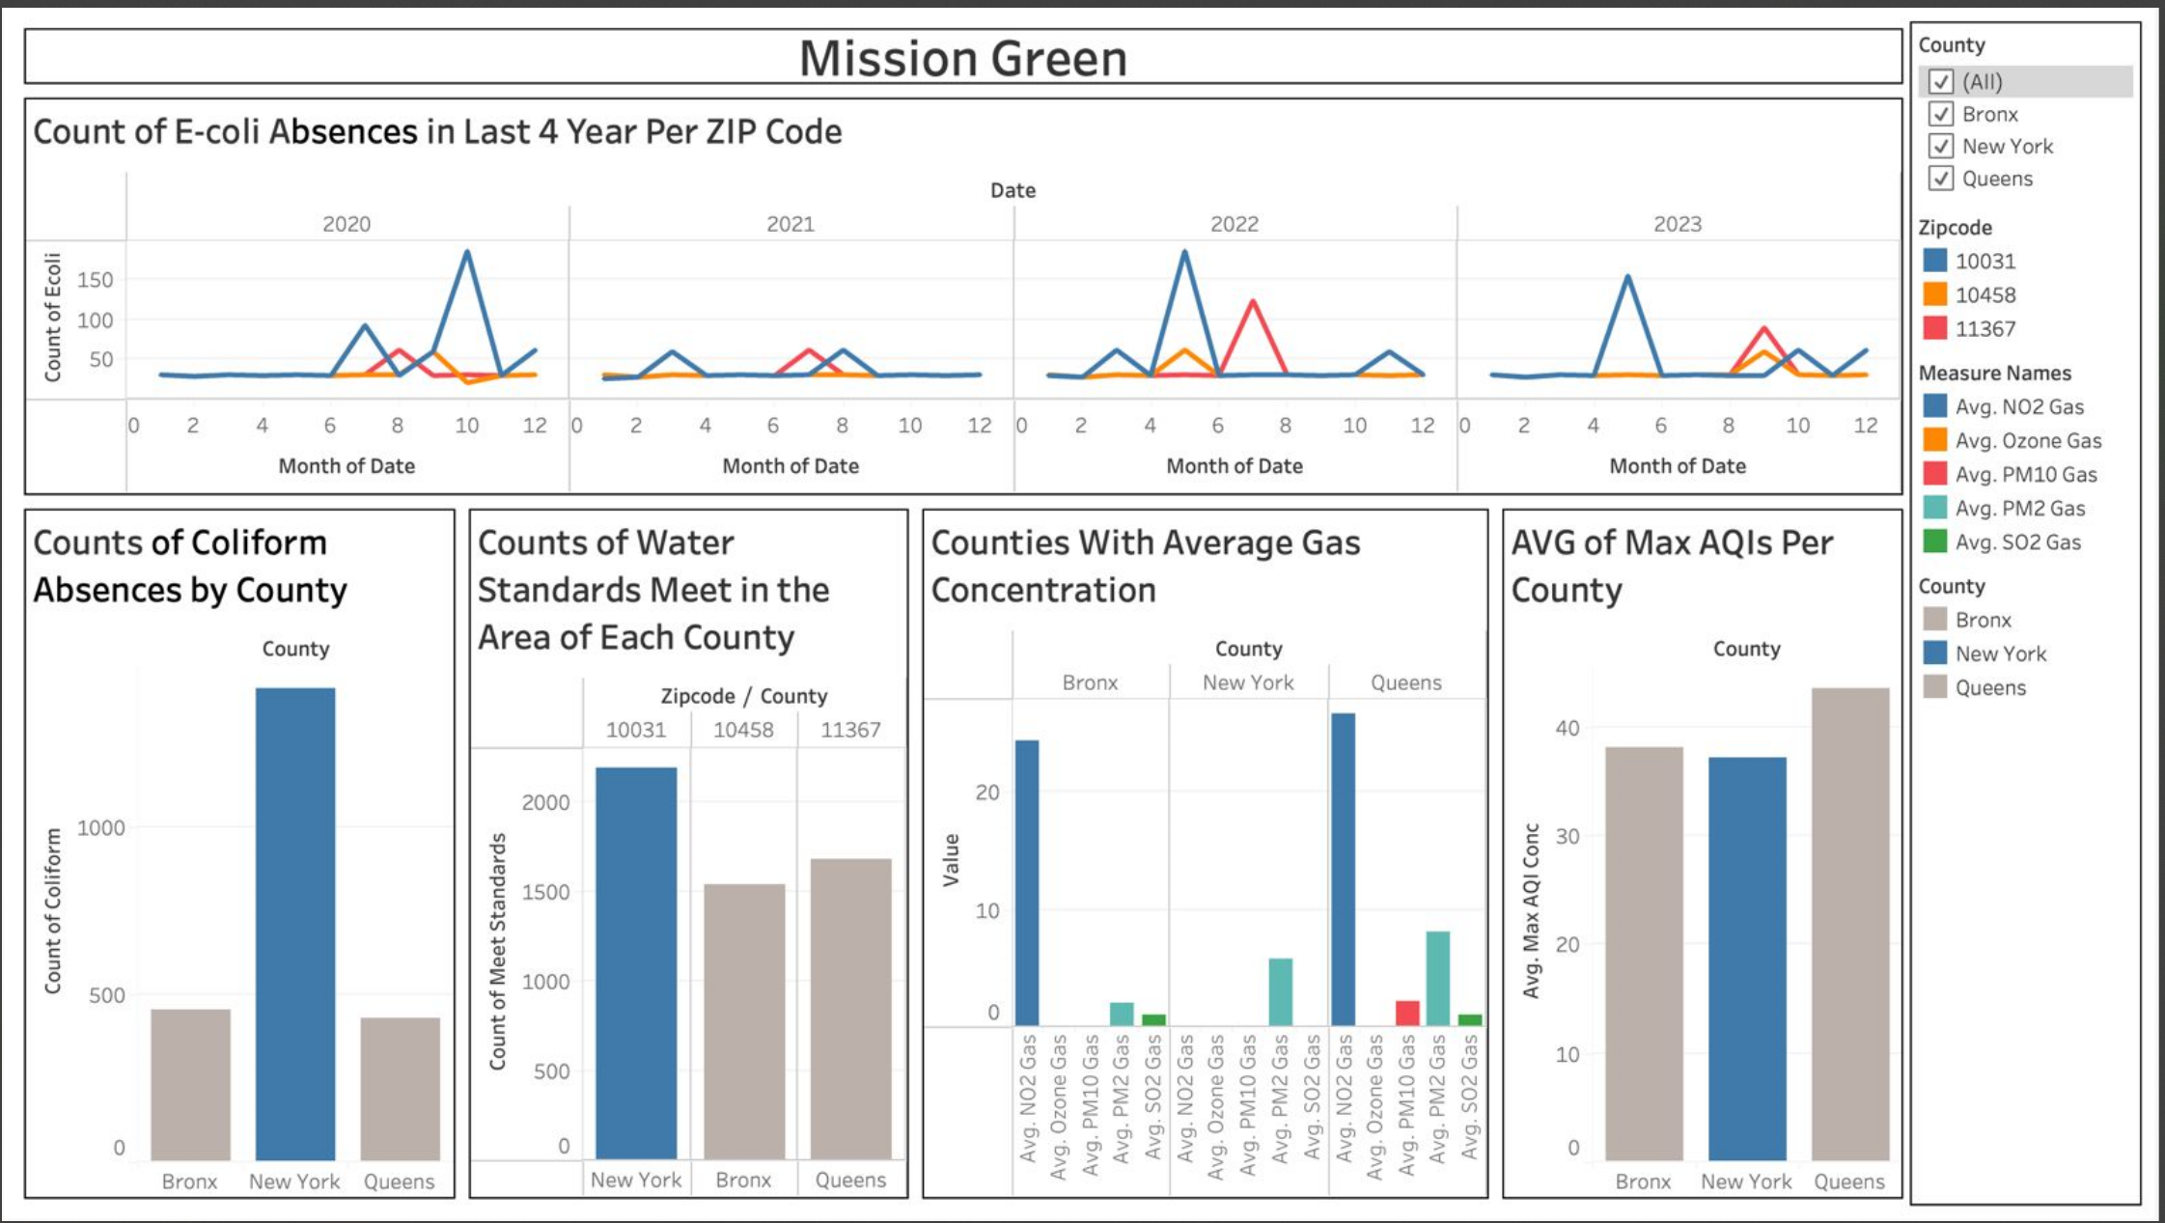
Tableau Dashboard

Slide 15

Assumptions
1
Data quality: Assuming that the data being collected is accurate, consistent, and reliable.
Schema stability: Assuming that the structure of the data will remain relatively stable over time, allowing for consistent data modeling
3
2
Integration readiness: Assuming that data from various sources can be integrated seamlessly into the warehouse without major compatibility issues.
Business requirements alignment: Assuming that the data warehouse design aligns with the business needs and objectives
4

Slide 16

Challenges
AWS Lambda integration: Troubleshooting and monitoring distributed lambda functions across multiple services can be complex.
Data scarcity: With insufficient data, it's challenging to extract meaningful patterns, resulting in incomplete or inaccurate analyses.
API limitations: Restrictions on the usage of zip conversion APIs may hinder data processing and integration, impacting the efficiency of workflows.
AWS Glue budget constraints: Limited budget allocations for AWS Glue services can restrict data transformation capabilities and scalability, posing challenges in managing large datasets effectively.

Slide 17

Lessons Learned
The following are the key lessons learned from the project.
Lambda for ETL: Leveraging Lambda for ETL tasks can enhance flexibility and scalability compared to traditional approaches, allowing for more efficient data processing.
Glue for migration: Limiting Glue usage to migration tasks helps streamline the ETL process and avoids unnecessary complexity in the data pipeline.
Data acquisition: Actively seeking and acquiring more data can enrich analytics and insights, contributing to better decision-making and problem-solving.
SNS Notification optimization: Optimizing SNS notifications at the RDS level instead of S3 can improve monitoring efficiency and reduce noise in alerts.

Slide 18
Any Questions ?

